Slide 1
DIVERSITY AND INCLUSION AT BAWAG GROUP

Slide 2
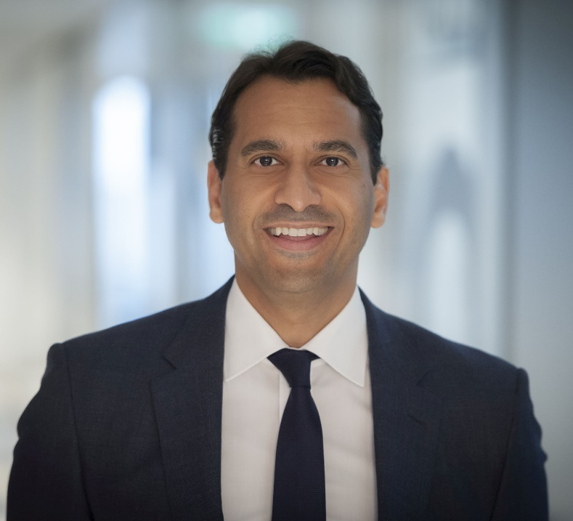
BAWAG Group is striving to be a meritocracy. The Management Board takes a great deal of pride in ensuring our company values are individual based on merits without bias towards age, gender, gender identity, color, ethnicity, sexual orientation, disability or religion.
This is what makes us a truly unique organization.
Anas Abuzaakouk Chief Executive Officer

Slide 3
AGE & GENERATION DIVERSITY
ORIGINS
All employees of BAWAG Group, whether full time or part time, are to be treated fairly and equally, regardless of age, gender, gender identity, disabilities, sexual orientation, origins (national and ethnic) or religion and beliefs.
We decline all forms of discrimination and see diversity and equal opportunities as a strength and competitive advantage.
We take a strong stance against all forms of mobbing, sexual harassment, intimidation and violence.
EMPLOYEES WITH
DISABILITIES
GENDER EQUALITY
RELIGION & BELIEFS
SEXUAL ORIENTATION

Slide 4
DIVERSITY AND INCLUSION IN BAWAG GROUP
Commitment by Management
Recruiting process
BAWAG Group lives diversity through its diverse Management Board and employees
We signed the Diversity Charter of the Austrian Federal Economic Chamber in 2010
Statement in our Code of Conduct applicable to employees, Management Board and Supervisory Board
We are a member of the UN Global Compact and commit to these principles
We commit to the principles of the UN Women's Empowerment Program
Our company values are based on the ILO Convention and the freedom of association which ensures that everyone is free to form and participate in groups
In our actions and conduct we consider human rights, including the OECD Guidelines and the UN Guiding Principles on Business and Human Rights
Our recruiting process is designed to prevent unconscious bias
We use gender-neutral wording in our job advertisements
We raise awareness to avoid stereotyping in the recruiting process
Trainings
Diversity values are communicated in leadership and potential programs
Online training on diversity for all employees via our online training tool
Specific diversity trainings on unconscious bias for recruiters and hiring managers
Raising awareness through communication
CEO Newsletters
Through our internal communication platforms (Intranet and MIA) and social media
In our communication we pay attention to taking diversity into account and preventing stereotyping

Slide 5
AGE & GENERATION DIVERSITY
We believe that age diversity in the workspace brings innovation and improves performance.
We benefit from mixing the diverse strengths and perspectives of younger and older employees.
4 Generations 1 Organization:
Our measures:
6%
BOOMER 1946-1964
In the hiring process, age is no determining factor
A certain age is no prerequisite for a promotion, education, or training
We have performance-related, age-independent remuneration systems
We take measures to maintain the health of our employees (e.g., company doctor, company health benefits, sports club)
Our office is equipped with ergonomic workstations
36%
GENERATION X
1965-1980
44%
GENERATION Y
1981-1996
15%
GENERATION Z 1997-2010

Slide 6
ORIGINS
We strive to attract and retain employees with diverse national and ethical backgrounds to build a workforce that represents the diversity of our society. We strongly believe the diversity of our employees helps us to work better together and brings greater innovation for our clients and our company.
Our measures:
In the hiring process, we give the same opportunities no matter where applicants come from or what color they have
A certain origin is no prerequisite for promotion, bonus, education, or training
We provide German and English language courses for our employees
To improve the intercultural competence of our employees, we offer online training via our online training tool goodhabitz for all employees
employees from over 50 nations

Slide 7
GENDER EQUALITY
We want our workforce to provide gender equality and equal opportunities for women and men. We strive to maintain and increase the number of female leaders in our company.
Overall gender distribution
Our measures:
In the hiring process, women and men are given equal opportunities
Among the participants in our potential and leadership programs, we value a balanced number between women and men
We support employees returning from parental leave and encourage part-time leadership roles
With the BAWAG Group Women´s Mentoring Program and our Women´s Initiative we want to further encourage and empower women in our company
56% Women
44% Men
WOMEN EMPOWERMENT PLAN SINCE 2012
Raising awareness
Equal career opportunities
Financial equality
Promoting a better balance between career and family for women and men

Slide 8
EMPLOYEES WITH DISABILITIES
We strive to be an employer that makes work accessible to all and further includes and supports employees with disabilities.
Our measures:
In our recruiting process, we apply the same standards for applicants regardless of disabilities
We consider the individual situation of employees with disability in the design and deployment of work
We consider accessibility at all levels
office and workstation for employees
accessible website and branches for customers
Workstation can be individually designed according to employees needs
Employees with disabilities receive additional vacation days according to our collective agreement

Slide 9
SEXUAL ORIENTATION
We aspire a workplace where every employee can be their authentic self and express their sexual orientation with pride and confidence.
Our measures:
Sexual orientation is not considered in any decisions, such as
Recruiting process
Job assignments
Promotions
Remuneration
Social benefits are available regardless of sexual orientation
Nursing leave
Paternity leave
Dad months
When designing external and internal communication materials, we commit ourselves to diversity. We don’t want to transport any stereotypes through visual language.

Slide 10
RELIGION & BELIEFS
BAWAG Group fosters a work climate of acceptance and understanding toward all religions, worldviews and lifestyles. We accept and appreciate different beliefs, views and opinions.
Our measures:
All major religious groups are represented among BAWAG Group employees
Tolerance and sensibility in multi-cultural teams is important to us as an organization
We tolerate different religious beliefs, political opinions, and philosophical beliefs. We strive to avoid conflicts by talking to each other and trying to understand and respect different point of view
Religious affiliation, world view or lifestyle are not considered in any decisions, such as
Recruiting process
Job assignments
Promotions
Remuneration
We encourage employees and managers to respect practices of religion when scheduling working hours or breaks (whenever possible)

Slide 11
PREVENTING
UNCONSCIOUS BIAS
The tendency to interpret new evidence as confirmation of one's existing beliefs or theories
The tendency for positive impressions in one area to positively influence one's opinion or feelings in other areas
HALO EFFECT
CONFIRMATION BIAS
Unconscious bias is a behavioral tendency to judge people and situations based on unconscious perceptual and learning mechanisms.
Over 175 biases determine thinking and influence decisions.
First step to prevent unconscious bias is to accept that we all have it. By being aware of how it influences our perception and decisions, we can face unconscious bias.
The tendency to assume that people who are physically attractive also possess other socially desirable personality traits
The tendency to prefer people who share qualities with us or someone we like
AFFINITY BIAS
BEAUTY BIAS
HOW TO TACKLE UNCONCIOUS BIAS IN THE WORKPLACE:
Slow down - unintentional bias is more likely when you make fast decisions.
Avoid making assumptions or relying on gut instinct.
Don’t stereotype individuals or groups (e.g., women – men, older – younger generations).
Speak out if you notice bias in your team or by your managers.
Learn more about cultural diversity and unconscious bias in the online training programs.

Slide 12
QUESTIONS & CONTACT
If you have any questions regarding diversity and inclusion in BAWAG Group contact hr@bawaggroup.com

